Slide 1

PLANT IMAGE DIAGNOSIS
By: Dinesh Kumar Rachhoya (11720074)
under supervison of:
Dr. Anoop Kumar Patel

Slide 2
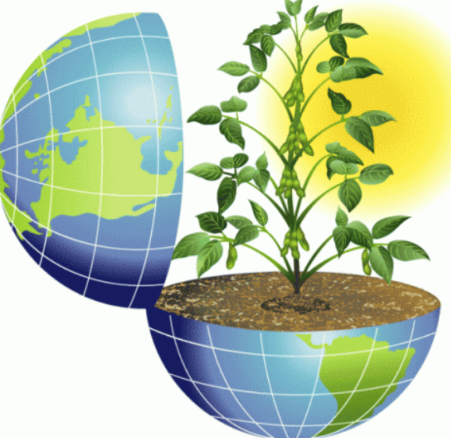
INTRODUCTION
This project is completely based upon deep learning concepts in which deep learning techniques are used to perform a particular task.This project consists of a large plant image data set. This data set consists of 38 classes of different plants. Each class consists of healthy and diseased leaves. This project basically worked on all the unhealthy leaves which are infected. Different deep learning techniques are used to diagnose these unhealthy leaves and predict a particular kind of disease related to the particular plant.Diagnosis undergoes different deep learning concepts such as pre-processing, segmentation, feature extraction and classification etc. All these deep learning techniques are worked together to diagnose a particular disease and predict a particular disease.
This project is worked on a large data set of plant leaves and this data set consists of 38 classes of different kind of images. Each class consists of healthy as well as unhealthy plant leaves which are processed for the diagnosis of identification of disease. Each class consists of approximately 2000 leaf images. And total images are approximately 74000. This large data set is divided into sub parts such as Plant village, test and train. Plant village is the base directory in which test and train sub directories are included.Test directory consists of 30% images of each class and train directory consists of 70% images of each class.
This project uses pre-defined libraries and modules such as :Panda, Pillow, Numpy, Opencv, Matplotlib, keras, Tensorflow.

Slide 3
Literature Review
Leaf Disease Severity Measurement Using Image Processing is basically proposed by SANJAY B. PATIL, Dr. SHRIKANT K. BODHE. They have worked on sugarcane crops which are infected by some kind of reason. According to them the have found the fungi caused disease in the sugarcane which is a most predominant disease and almost appears or occurs as the spots on the sugarcane leaves. If these disease are not treated on time they will cause to a severe loss in the crops. According to them this disease appeared on the leaves as spots due to excessive use of the pesticides. The excessive use of pesticides can cause the environment pollution and increment in the cost . So there should be proper use of pesticides after knowing the actual problem. And that will help in reducing the environment pollution and reduces the cost also. Disease can be categorized by calculating the lesion quotient and area of the leaf. And they found the accuracy of this experiment is approximately 98.60. And they found that this method is fats and accurate in the detection of disease. They found that severity of the disease mainly depends on the disease segmentation. As they have told that threshold segmentation can be used for calculation of leaf area but it is not appropriate for the legion region due to the varying characteristics. They found the average accuracy of the experiment is approximately 98.60%. they told that image processing technologies are more fast and accurate in measuring plant disease severity. Tradition methods of disease detection are not that much accurate and fast and there was a probability of having an error. So Modern image processing techniques are more powerful and accurate in detecting the disease severity.
Leaf Disease Detection Using Image Processing is basically a proposed paper by SUJATHA R, Y SRAVAN KUMAR, and GARINE UMA AKHIL. According them India is a farming based country an India produced a lot of yield from the farming. They have concerned about the farmers because they faced lot of disease infections on their crops . They have designed such a system which can help the farmers in detecting the problems with their crops. They have worked on image processing technology for implementing the system. They have used a proposed methodology in which following process are used: Image acquisition that select the affected part an load into the system. Image segmentation which divides the the images into smaller segments for the clear vision of the image. And used K-means clustering algorithm for the segmentation ans support vector machine for some statistical data. Feature extraction is used for finding features based on the shape and color. All these technology are used in the detection of plant disease. These technologies are very useful for the farmers to detect the problems in crops and produce large yields.

Slide 4
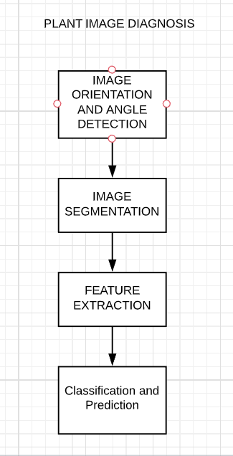
Proposed Approach
Plant Image Diagnosis, we have divided this project into four parts. These four parts are as follows:
1. Image Orientation and angle detection
In this part we have have defined the rotations of the images which can be rotated at any desired angle and we and we have also find the angle of the images situated in any dimension.
2. Image Segmentation
Image segmentation basically identify more than one objects in a image. We can divide or partition the image into various parts called segments. It’s not a great idea to process the entire image at the same time as there will be regions in the image which do not contain any information. By dividing the image into segments, we can make use of the important segments for processing the image. That, in a nutshell, is how image segmentation works. An image is a collection or set of different pixels. We group together the pixels that have similar attributes using image segmentation
3. Feature Extraction
Feature extraction is another image processing technique which is used to extract features or characteristics from the images. Features can be based upon shape , color etc.
4. Classification and Prediction
In the classification and disease prediction all the plant species will be train and classify the individual type of plant species. Classification will be done with the help of dense net model of CNN.

Slide 5
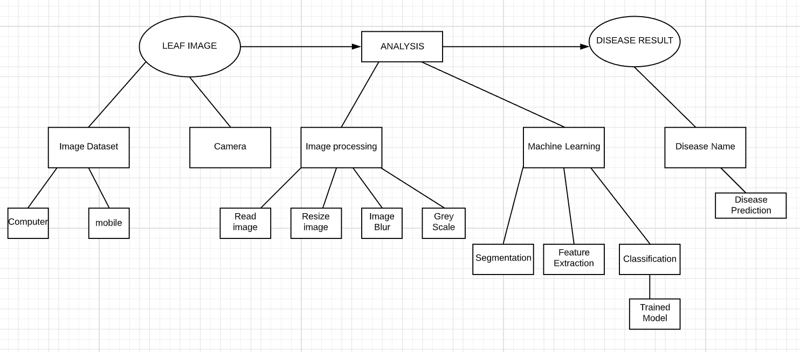
Dataflow Diagram of Proposed Work

Slide 6
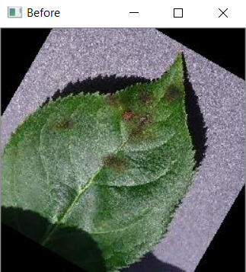
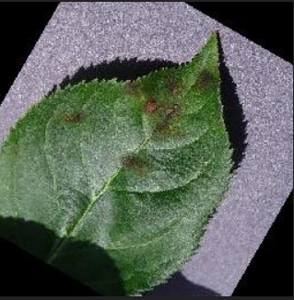
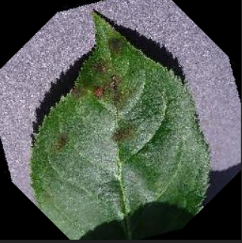
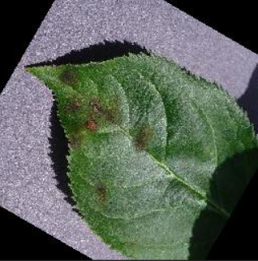




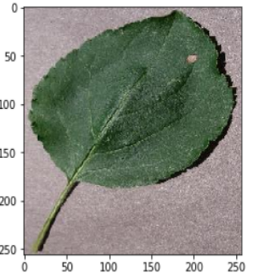
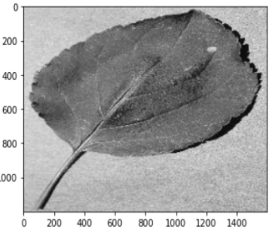
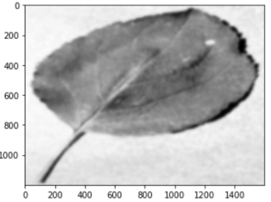
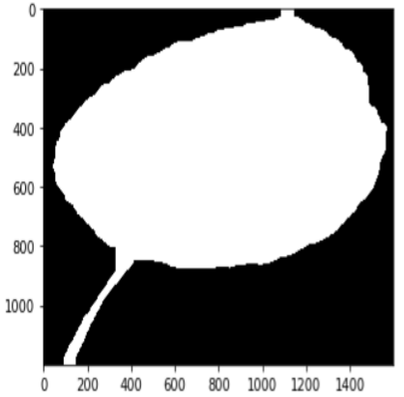
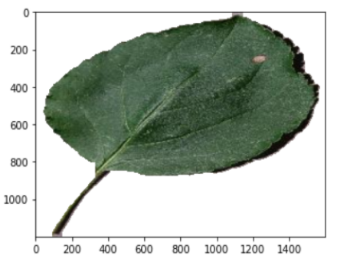
Experiental Evaluation, Results And Discussion
1. Image Orientation And Angle Detection
The outputs which come up after the Experiment evaluation.
2. Image Segmentation
Image segmentation perform the follwing processes:
Read Image Convert to Grayscale Smoothing Morphological trans. Segmented Image After masking

Slide 7
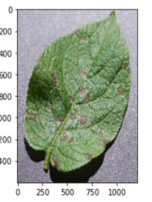
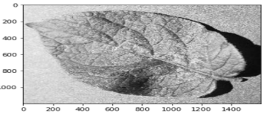
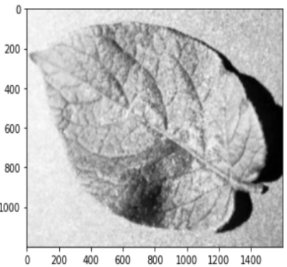
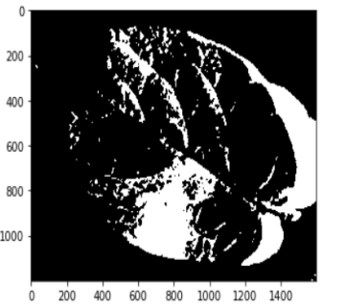
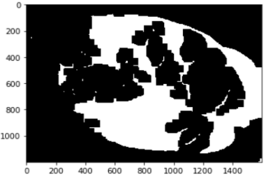
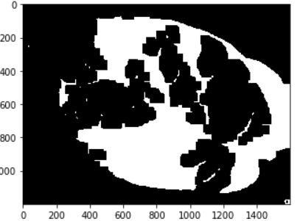
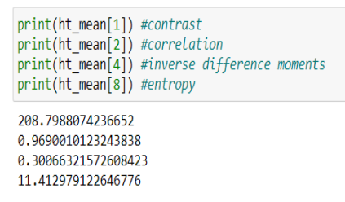
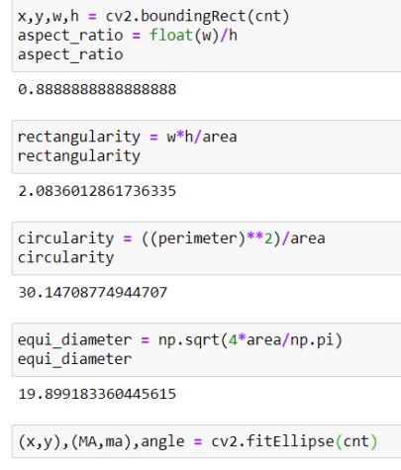
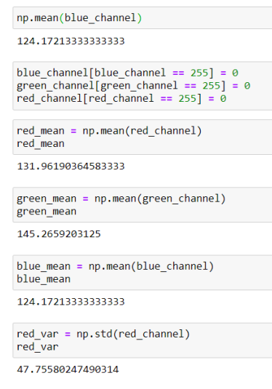
Cont...
3. Feature extraction
Oprations performed for the feature extraction are as follows:
Read Image Convert to Grayscale Smoothing Thresholding Boundary Extraction using contours Fit best rec n elip
3.1 Shape based features 3.2 Color based features

Slide 8
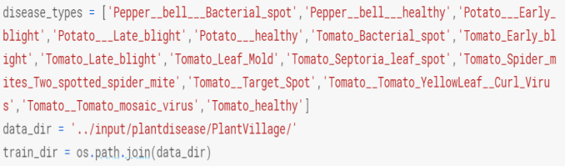
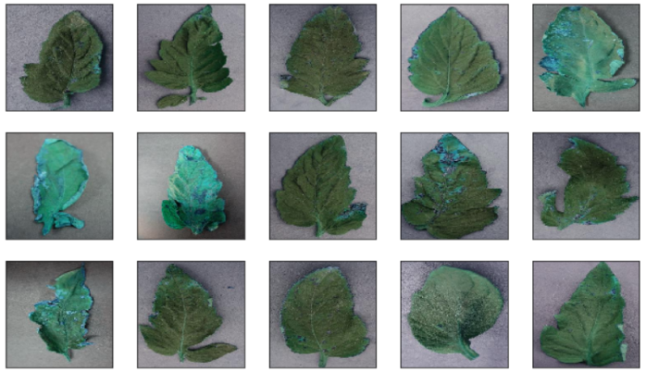
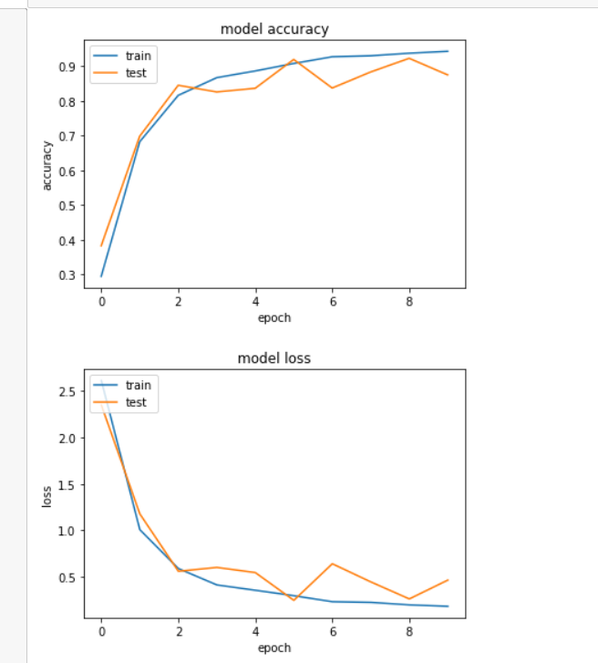
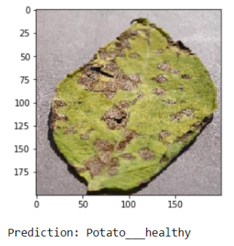
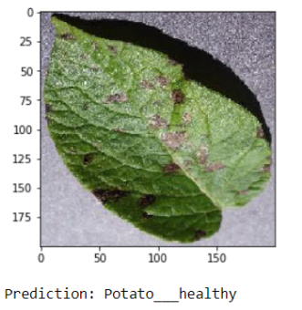
Cont...
4. Classification and Prediction
Some results based upon classification and prediction.
Disease types Visualization
Accuray and Loss plot Disease Prediction

Slide 9
References
1. Sujatha R* , Y Sravan Kumar and Garine Uma Akhil, Leaf Disease Detection, School of Information
Technology and Engineering, VIT University, Vellore.
2. Sanjay B. Patil, Dr. Shrikant K. Bodhe,Leaf Disease Severity Management Using Image Processing Dept
of E &TC Engg. Rajgad Dyanpeeth Technical Campus, Bhor, Dist-Pune, (M.S.), India.
3. Image Classification: http://www.geeksforgeeks.org
4. Image Segmentation and Feature Extraction: http://www.tensorflow.org
5. Basic information about Plants: http://www.wikipedia.org
6. Leaf Image Data set: http://www.kaggle.com
7. Image Orientation and rotation: http://www.stakoverflow.com

Slide 10
THANKS

